Slide 1
Concurrent Programming

Slide 2
Process:
A process is a program in execution.
It is a self-contained unit of execution that contains its own code, data, and memory space.
A process can have multiple threads of execution, which allows it to perform multiple tasks simultaneously.
Thread:
A thread is a lightweight process that shares the memory space of its parent process.
Threads are often used to improve the performance of a process by allowing it to perform multiple tasks simultaneously.

Slide 3
Multi-Threaded Programming:
Multi-threaded programming is a technique that allows a program to run multiple threads of execution simultaneously.
This can improve the performance of a program by allowing it to perform multiple tasks simultaneously.
Advantages of Multi-Threaded Programming:
Improved performance, Increased responsiveness, Better resource utilization, and Easier to develop and maintain complex applications.

Slide 4
Disadvantages of Multi-Threaded Programming
Increased complexity, Potential for race conditions, and Increased memory usage.
When to Use Multi-Threaded Programming
Multi-threaded programming is a good choice for applications that need to perform multiple tasks simultaneously, such as web servers, database servers, and video games.
It is also a good choice for applications that need to be responsive to user input, such as graphical user interfaces.

Slide 5
When to Avoid Multi-Threaded Programming
Multi-threaded programming is not a good choice for applications that are not CPU-bound, such as I/O-bound applications.
It is also not a good choice for applications that are difficult to parallelize, such as numerical algorithms.

Slide 6
What is Thread?
A thread is the subset of a process and is also known as the lightweight process.
A process can have more than one thread, and these threads are managed independently by the scheduler.
All the threads within one process are interrelated to each other.
Threads have some common information, such as data segment, code segment, files, etc., that is shared to their peer threads.
But contains its own registers, stack, and counter.

Slide 7
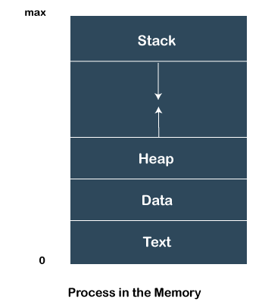

Slide 8
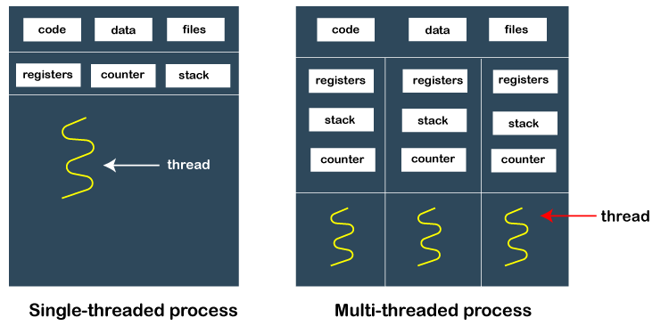

Slide 9
How does thread work?
As we have discussed that a thread is a subprocess or an execution unit within a process.
A process can contain a single thread to multiple threads. A thread works as follows:
When a process starts, OS assigns the memory and resources to it. Each thread within a process shares the memory and resources of that process only.
Threads are mainly used to improve the processing of an application. In reality, only a single thread is executed at a time, but due to fast context switching between threads gives an illusion that threads are running parallelly.
If a single thread executes in a process, it is known as a single-threaded And if multiple threads execute simultaneously, then it is known as multithreading.

Slide 10
Types of Threads
1. User Level Thread
As the name suggests, the user-level threads are only managed by users, and the kernel does not have its information.
These are faster, easy to create and manage.
The kernel takes all these threads as a single process and handles them as one process only.
The user-level threads are implemented by user-level libraries, not by the system calls.
2. Kernel-Level Thread
The kernel-level threads are handled by the Operating system and managed by its kernel. These threads are slower than user-level threads because context information is managed by the kernel. To create and implement a kernel-level thread, we need to make a system call.

Slide 11
Features of Thread
Threads share data, memory, resources, files, etc., with their peer threads within a process.
One system call is capable of creating more than one thread.
Each thread has its own stack and register.
Threads can directly communicate with each other as they share the same address space.
Threads need to be synchronized in order to avoid unexpected scenarios.

Slide 12
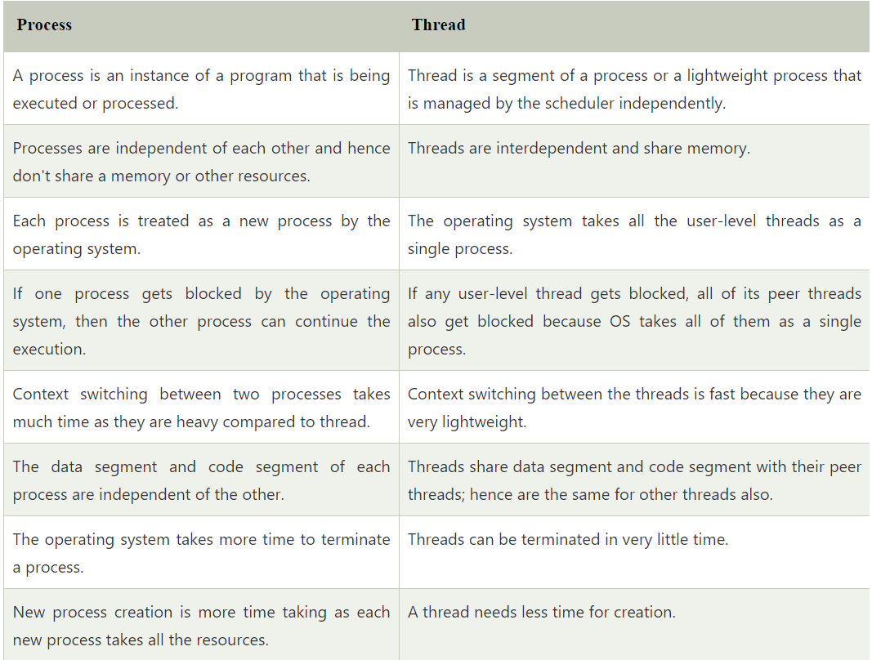

Slide 13
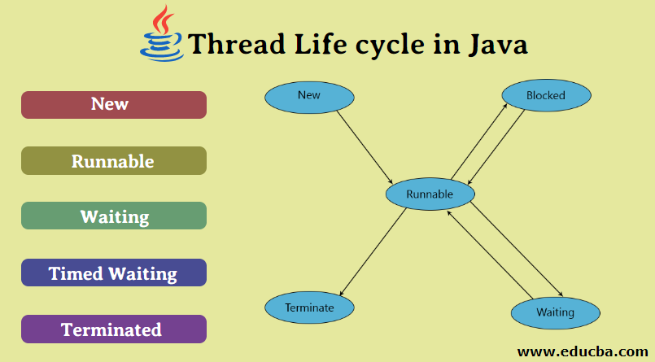

Slide 14
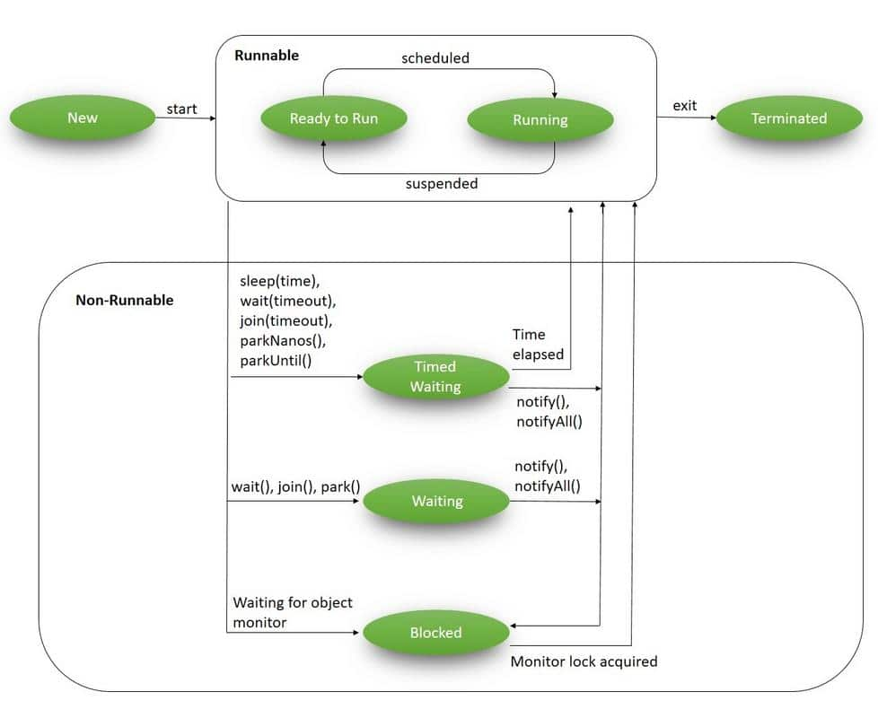

Slide 15
States of Thread Life Cycle in Java
1. New: A new thread starts its life cycle inside the new state. It continues to be with this state before the program begins the thread. Additionally, it is known as a created thread.
2. Runnable: After a recently born thread can begin, the thread turns into runnable. A thread with this state is considered performing their process.
3. Waiting: Occasionally, a thread transition towards the waiting around the state even though the thread is waiting for another thread to execute an activity. A thread transition to the runnable state only if an additional thread indicates the waiting thread to keep performing.
4. Timed Waiting: A runnable thread cans easily the particular timed waiting for the state to get a specific interval of the time. A thread with this state transitions returning to the runnable state once that point interval expires or if the event it truly is awaiting happens.
5. Terminated: A runnable thread gets into the terminated state because it accomplishes its task or else terminates.

Slide 16
How to create a thread in Java
There are two ways to create a thread:
By extending Thread class
By implementing Runnable interface.

Slide 17
Thread class:
Thread class provide constructors and methods to create and perform operations on a thread.
Thread class extends Object class and implements Runnable interface.
Commonly used Constructors of Thread class:
Thread()
Thread(String name)
Thread(Runnable r)
Thread(Runnable r,String name)

Slide 18
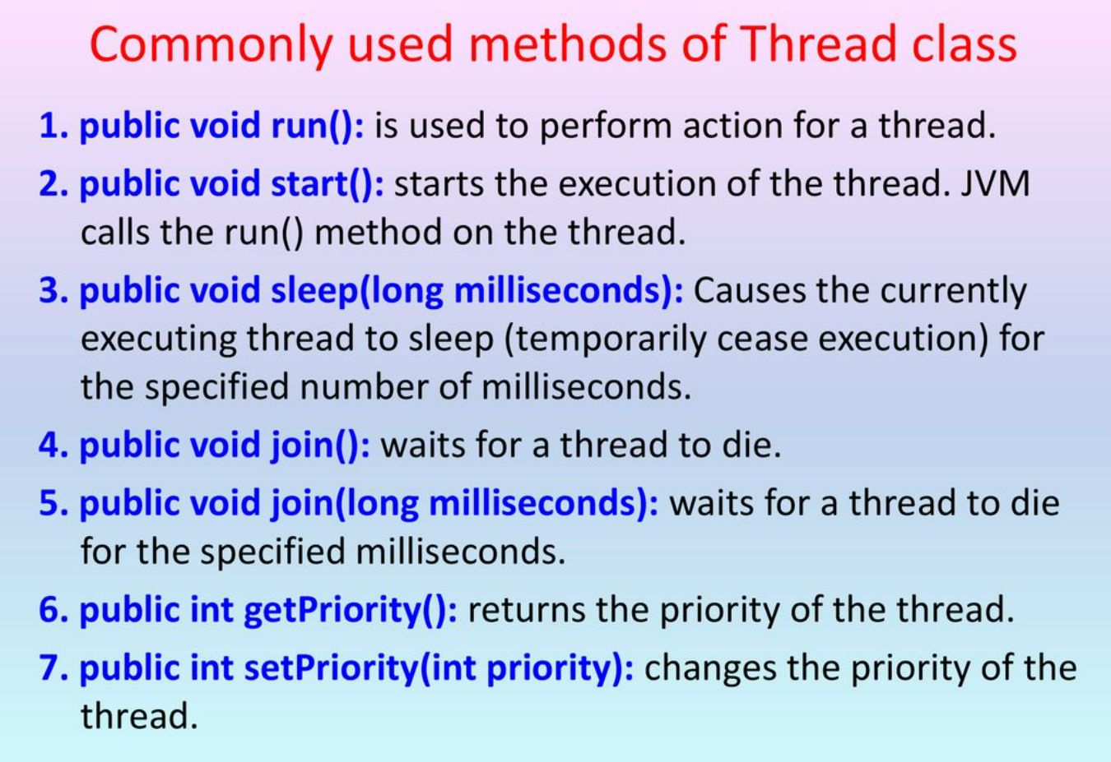

Slide 19
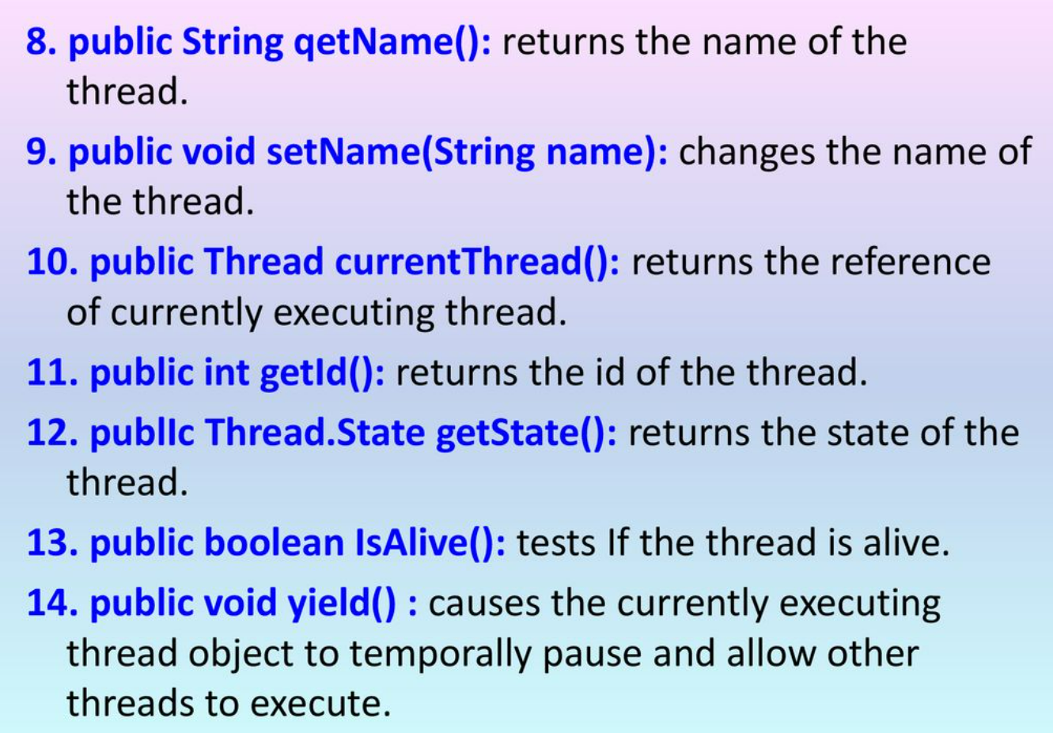

Slide 20
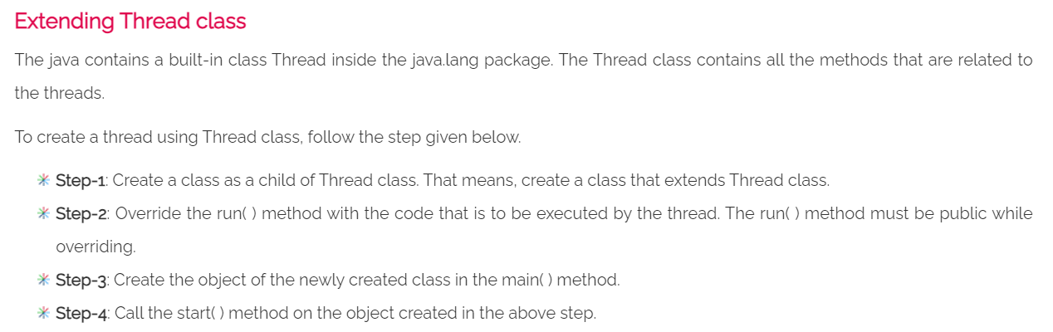

Slide 21
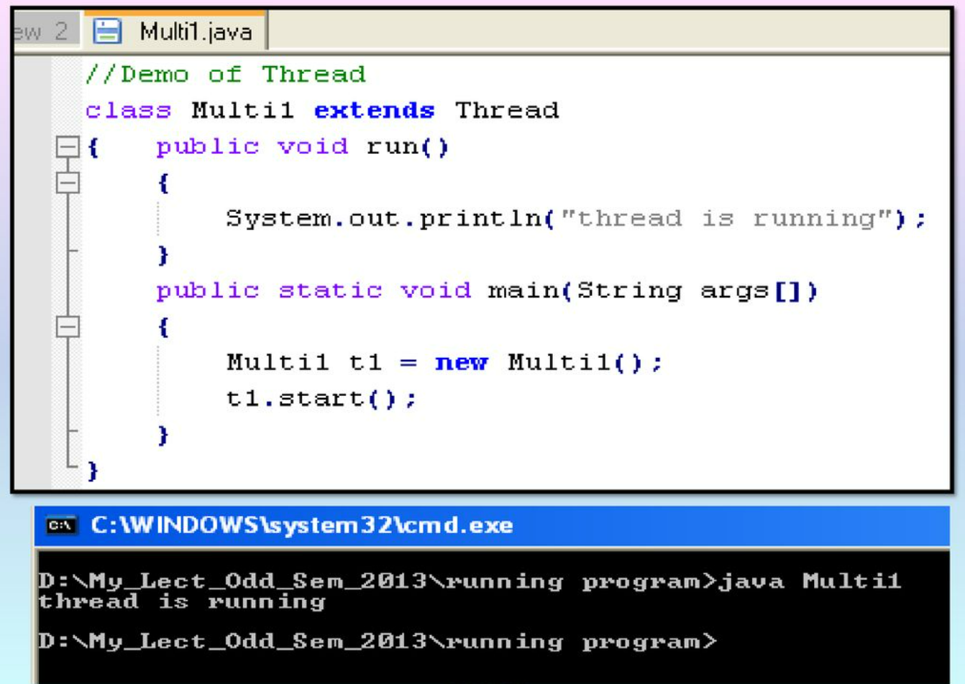

Slide 22
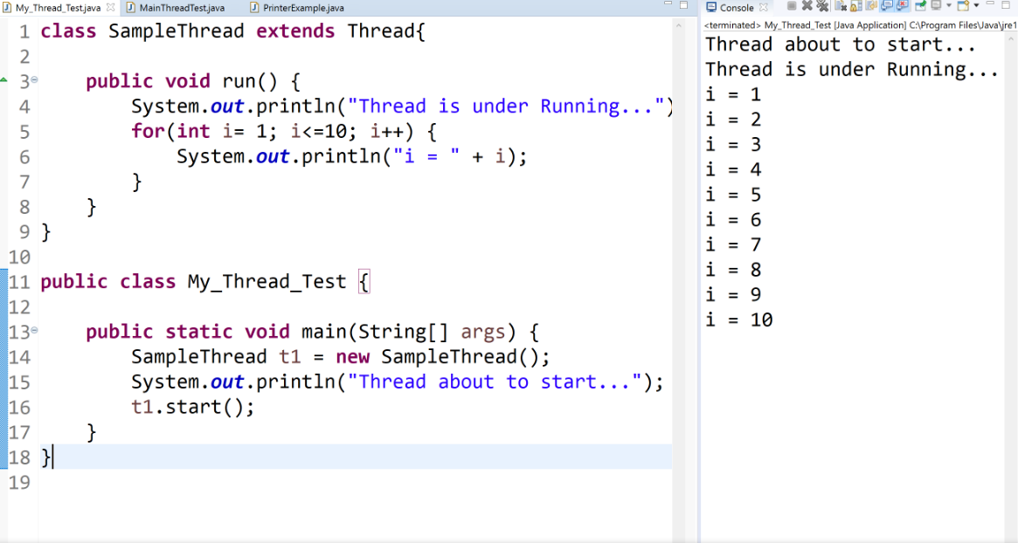

Slide 23
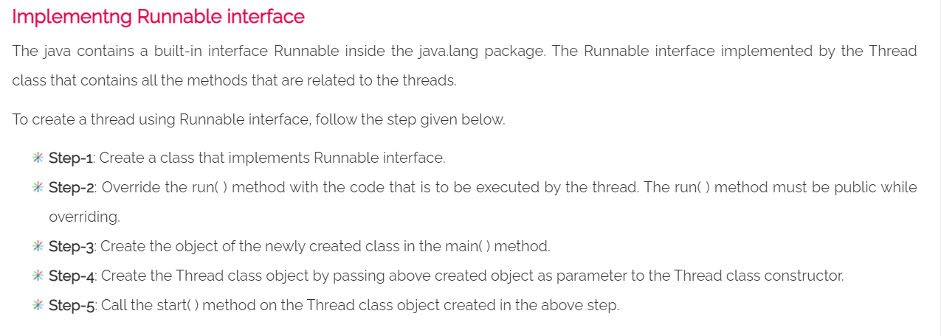

Slide 24
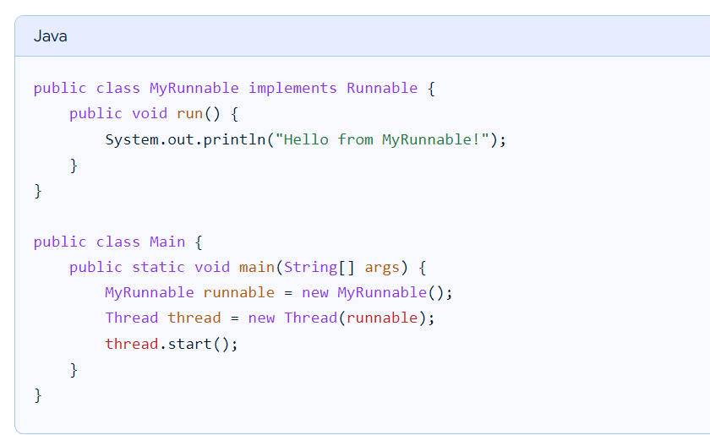

Slide 25
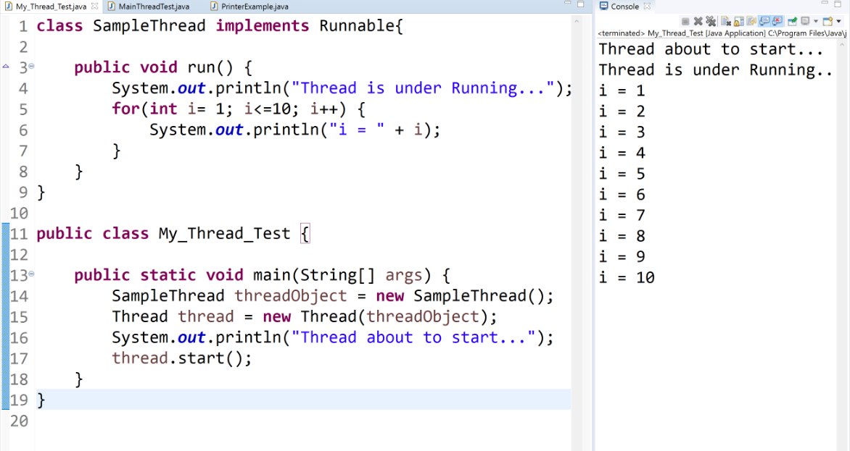

Slide 26
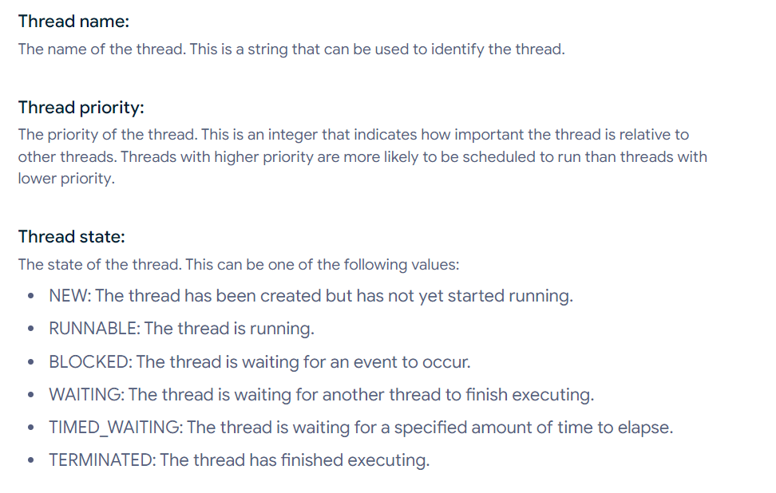
Thread Properties

Slide 27
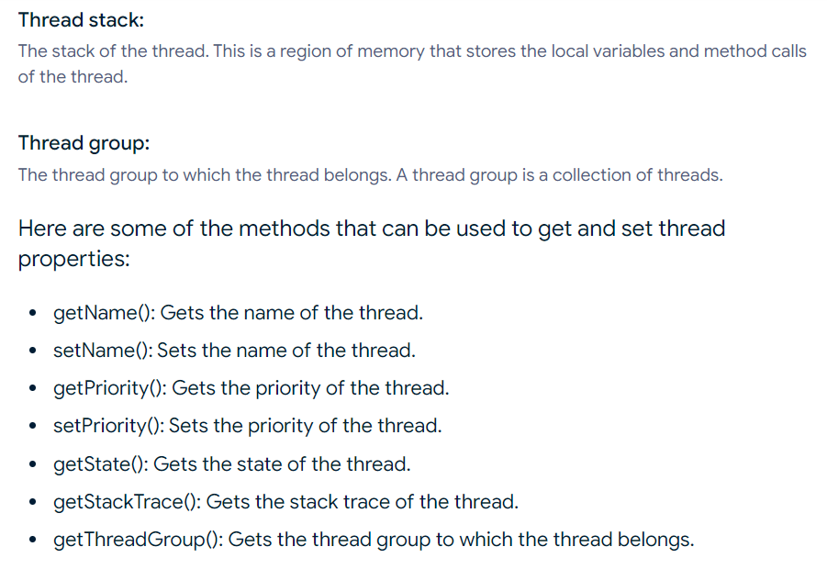

Slide 28
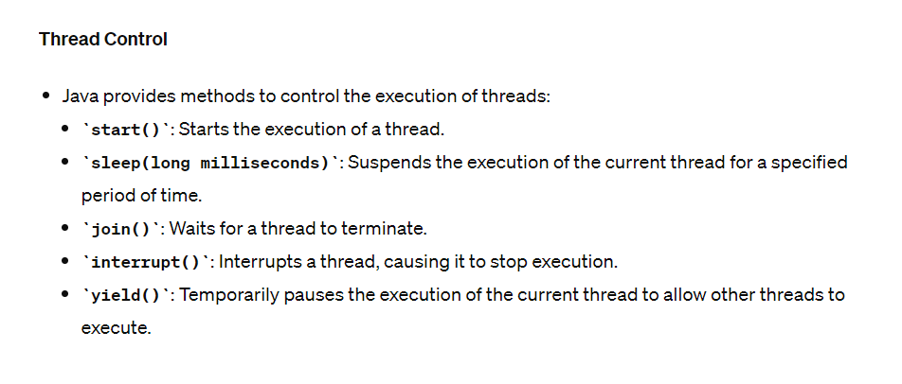

Slide 29
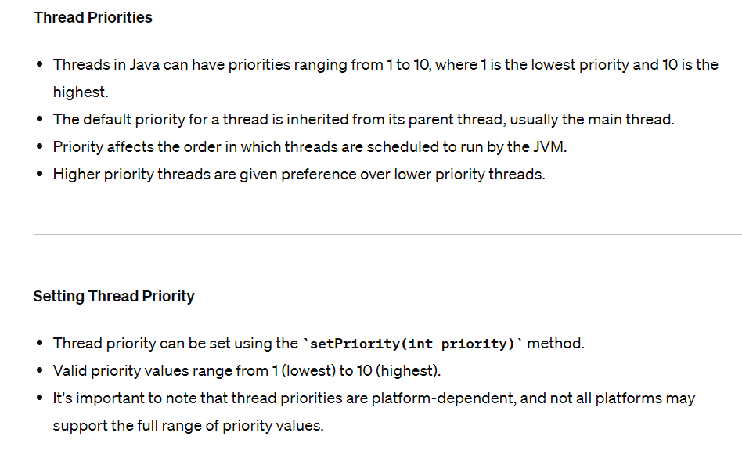

Slide 30
Interrupting Threads
In Java, interrupting a thread is a way to signal to the thread that it should stop what it is doing and do something else.
It's up to the programmer to decide exactly how a thread responds to an interrupt, but it is very common for the thread to terminate.
There are two ways to interrupt a thread:
Using the interrupt() method:
You can use the interrupt() method to send an interrupt signal to the thread. The thread should be designed to handle this interrupt and exit gracefully.
Throwing an InterruptedException:
You can throw an InterruptedException from a method that is being called by the thread.
This will cause the thread to be interrupted and the InterruptedException to be propagated up the call stack.

Slide 31
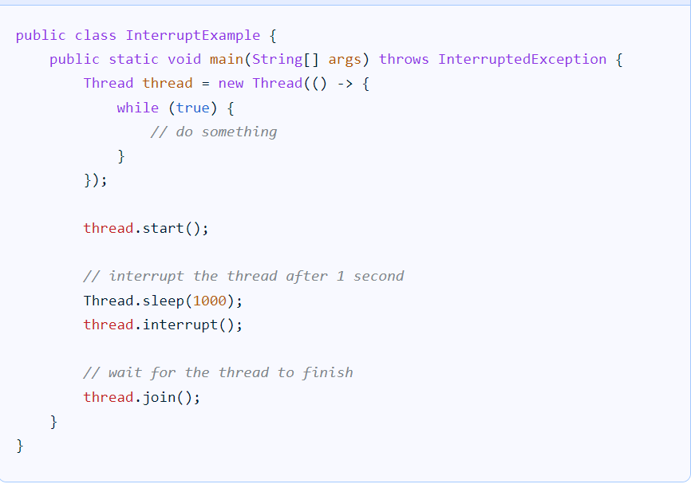

Slide 32
